Slide 1
Navigating Covid-19 with nOVEl intervention strategies to reach women impacted by intimate partner violence
Louisa Gilbert
Dawn Goddard-Eckrich
Anindita Dasgupta
Danil Nikitin
Tina Jiwatram-Negron
Ariel Richter
Timothy Hunt
Elwin Wu
Nabila El-Bassel
Social Intervention Group

Slide 2
Poll: Your background
What is your primary work setting?
Health care
Criminal justice setting
Domestic violence program
Other social service setting
University/Research Center
Independent or Other

Slide 3
Poll: Your background
If you work with survivors of domestic violence,
how many years have you worked with them?
0 years
1-2 years
3-5 years
6+ years

Slide 4
How confident are you to screen women for intimate partner violence and link them to services?
POLL
Not at all confident
A little confident
Somewhat confident
Confident
Very Confident

Slide 5
Overview of Presentation
Overview of Presentation
Definition and Scope of different types of IPV
How are social distancing and economic effects of COVID-19 triggering intimate partner violence (IPV)
Applying Syndemic Framework for addressing co-occurring COVID-19 and IPV epidemics and their structural drivers
Overview of SBIRT (Screening, Brief Intervention, Referral to Treatment) Model of WINGS (Women Initiating New Goals of Safety) to identify and address IPV
Assessing organizational readiness for implementing WINGS
Future Directions for WINGS in times of COVID

Slide 6
What is Intimate Partner violence?
Intimate partner violence (IPV) constitutes “a constellation of controlling behaviors” that includes physical, sexual, Psychological and economic Abuse and threats”
Power and Control Wheel: Intimate Partnerships are on a spectrum from ”Equality” to ”Power and Control”

Slide 7
Scope of IPV in U.S.
1 in 3 women and 1 in 7 men in the U.S. experience physical and sexual IPV in their lifetime. (CDC, 2010)
in recent years, the number of IPV cases has spiked, making up more than half of all serious violent crimes in the U.S. in 2018
Every day: 3 women in the U.S. are murdered by a partner (CDC, 2010)
Almost half (47.5%) of American Indian/Alaska Native women, 45.1% of non-Hispanic Black women, 37.3% of non-Hispanic White women, 34.4% of Hispanic women, and 18.3% of Asian-Pacific Islander women experience IPV in their lifetime. (CDC, 2017)

Slide 8
Considering the universality and intersectionality of IPV survivors
IPV varies culturally and covers a wide range of dating, sexual and marital relationships that occur from adolescence to elderly
Prevalence rates are similar among women and in same sex and heterosexual relationships, but higher among women and men who identify as bisexual (Breiding et al., CDC, 2015)
This presentation will focus mostly on women survivors in heterosexual and/or same sex intimate relationships

Slide 9
Alarming increase in Domestic violence In the U.S. since onset of covID-19
In New York State, DV Reports Overall Are Up 30 Percent in April 2020 Compared to Last Year and Incident Calls to State Have Increased 15 Percent in March Compared to Last Year
In the U.S, there has been a sharp rise in the number of domestic violence calls made to law enforcement agencies
Google reported a 75% increase in Internet searches relating to support for domestic abuse (Poate 2020).

Slide 10
SPIKES in Domestic violence In the U.S. since onset of covID-19
China’s Hubei Province recorded a tripling of domestic violence reports in February 2020 during the COVID-19 quarantine (John, 2020)
In France, reports of domestic abuse have increased 32 percent since quarantine measures were implemented
In Tunisia, in the first five days after people were ordered to stay in, calls to a hotline for women suffering abuse increased fivefold
in Spain, calls to domestic hotline have increased 18 percent, but a state-run hotline website has seen a 270-percent increase.

Slide 11
UNTF Rapid Assessment of violence Against women since covid onset
Interviewed 122 NGOs or government agencies in 69 countries in April 2020 (Majumdar, 2020)
Found significant increases in reports of violence against women since COVID social isolation restrictions
Reported women experiencing violence faced major barriers accessing emergency care, police response and orders of protection
DV programs are pivoting using technology – social media outreach, chat oriented 7/24 hotlines and deploying DV resources and services in grocery stores, pharmacies, and streets
Similar surges in IPV found during other pandemIcs (Ebola) and other disasters (Hurricane Katrina, Deep Water Horizon)

Slide 12
COVID-19 – ACTUAL & PERCEIVED HEALTH, SOCIAL & ECONOMIC EFFECTS ON IPV
COVID- risks for IPV
Shelter-in-place
Social Isolation
Economic Distress (Unemployment of Survivor & Partner)
Daily Household Stress
Parental Stress
Substance Misuse
Psychological Distress
Interruptions in Treatment/
Medications(Birth Control)
Spike in Gun Sales
IPV OUTCOMES
Frequency/ severity of IPV
# of people experiencing IPV who are able to access IPV services
Equity in access to IPV services by race, gender, sexual orientation and class
IPV SERVICE THREATS
Increased Demand for IPV services & Decreased Capacity
Threat of Burnout of DV staff
Delayed Emergency Response Decreased Court Capacity
Decline in funding for IPV services
Decrease capacity for surveillance
Lack of access to safe havens-churches, libraries, schools
IPV SERVICE OPPORTUNITIES
Building online telehealth capacity of IPV services Mainstream IPV service spots – pharmacies/grocery stores
Enhanced Community Social Capital “We’re in this together”
Mobilizing online Social Network

Slide 13
Applying syndemic framework to understand and tackle co-occuring COVID and IPV pandemics
Racism
COVID-19 &
Intimate Partner Violence
Lack of access to universal healthcare
Mass incarceration
Syndemic = When 2 or more epidemics/pandemics synergistically interact with each other and are reinforced by harmful social conditions that contribute to the formation, clustering, and spread of epidemics and excessive burden of disease in minority communities (Singer, 1996)
Income inequality

Slide 14
The Structural Drivers of COVID-19 and IPV Syndemic
RACISM INCOME INEQUALITY MASS INCARCERATION
LACK OF UNIVERSAL HEALTH CARE
COVID Racial Disparities
IPV Disparities
Access to PPE
Social Distancing
Access to COVID Testing
% of Essential Workers
Access to Health Care &Telehealth
% of people with
underlying
conditions
# of COVID cases
# of COVID hospitalizations
# of COVID Deaths
Access to Health/Telehealth Care
Black & Latinx women less likely to call police, access IPV services and courts
Black & Latinx women less likely to call 911
Rates of DV homicide much higher among
Black, Latinx, &
Native women

Slide 15
A Neighborhood Look at COVID & IPV syndemic in NYC: It’s about zip code, not genetic code
Total # of COVID-19 cases by zip code in NYC
% of Families with children eligible for shelter due to domestic violence by community district in NYC

Slide 16
Next steps in tackling COVID-19/IPV SYNDEMIC
Conduct routine surveillance and mapping of real time IPV reports along with COVID-19 cases, hospitalizations, & deaths to identify geographic clusters burdened by both IPV and COVID-19
Increase public awareness on increased risks of IPV during quarantine and how to safely access support through social media/ traditional media campaigns
Conduct innovative outreach to engage individuals at risk and link them to IPV services – use trusted sources and safe technology platforms to meet individuals at risk where they are at.
4. Provide training on IPV Screening Brief Intervention and Referral to Treatment (SBIRT) service models to staff in units, clinics and community screening dedicated to the COVID-19 and contact tracing
URGENT NEED TO IDENTIFY INDIVIDUALS SHELTERED AT HOME AT RISK OF IPV IN HIGH BURDEN COMMUNITIES

Slide 17
Origins of wings computerized IPV prevention SBIRT tool
Only 6% of women who use drugs who need IPV services are receiving it (Gilbert et al., 2015)
Challenge: How do we find the 90% or more of women who use drugs (WUD) who are experiencing IPV or dating violence and link them to violence prevention services?
Where to find women who need IPV services and substance abuse treatment?
Community
Corrections
Emergency
Care
Schools/
Social Media
HIV /STI Prevention and Care

Slide 18
WINGS: An Evidence-based SBIRT Model to address IPV
WINGS is a one or two session evidence-based SBIRT model designed to address IPV and other types of gender-based violence (GBV) for women who use drugs
WINGS has also been used to collect aggregate data on different types of violence against women who use drugs and to raise awareness and inform community level advocacy and policy initiatives
WINGS is designed for women with same sex and/or opposite sex partners

Slide 19
Integrating Motivational Interviewing (MI) in WINGS SBIRT
Motivational Interviewing (MI) a client-centered method of communication for strengthening internal motivation for change
Affirms women themselves as experts on their issues and as the primary agents of addressing IPV, substance misuse and other co-occurring problems
Harm reduction approach to improving relationship safety and reducing risks for IPV
OARS is core clinical skill of MI that is used in WINGS and other SBIRT models
O= Ask Open-Ended Questions
A= Actively affirm and validate
R= Reflective listening
S= Summarize

Slide 20
Psycho-Educational Principles of WINGS
Engage women as equals & experts on their own situation
Evocation
Advocacy
Draw out ideas and solutions from women
Strengths-based
Social Justice Lens
Decision making left to women
Identify and Redress Isms and structural barriers to resources and services
Engage and mobilize key stake holders from affected communities
Strengths-based with focus on reinforcing resiliency
Coordinate Community Response
Create learning exchange
Think and Reflect together
Recognizes racism, classism, heterosexism are structural drivers of violence
Collaboration
Culturally Tailored

Slide 21
Core components of WINGS
WINGS may be delivered as a computerized self-paced model or computer assisted or traditional SBIRT model that may delivered by a case manager, helping professional, outreach worker or trained peer advocate with following components
1. Brief psychoeducation on substance misuse and experience of different types of IPV and GBV (use OARS and learning exchange approaches)
2. Screening for different types of IPV and provide feedback on risks (use OARS)

Slide 22
WINGS components - continued
3. Eliciting motivation to address IPV and relationship conflict (Use MI: OARS, weighing pros and cons of change, highlighting change talk)
Physical, Sexual and Emotional Safety Planning Tool (Use MI: OARS and providing a menu of choices)
Social Support Network Enhancement (use OARS – Provide Menu)

Slide 23
WINGS components- continued
6. Identify and Prioritize Service Needs
(Use OARS and Provide Options)
7. Linkage to IPV and other Services
(MI: use OARS and Provide Options)
8. Goal setting to improve relationship safety and reduce IPV (MI: Identify Client-driven Goals using OARS and SMART Goals)

Slide 24
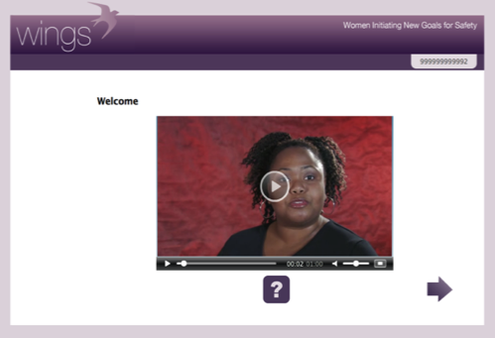
Computerized self-paced WINGS
Self-paced web-based tool with audio may be delivered on smart phones/computer
Covers same core components using interactive exercises, videos, narrative characters, and computerized feedback.
Demonstration video: https://www.youtube.com/watch?v=LpMpef-IRzQ

Slide 26
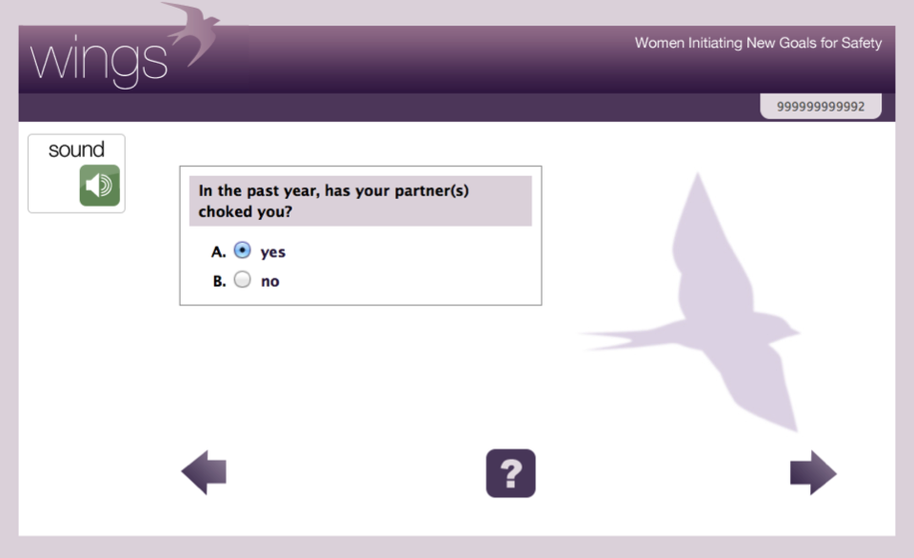

Slide 27
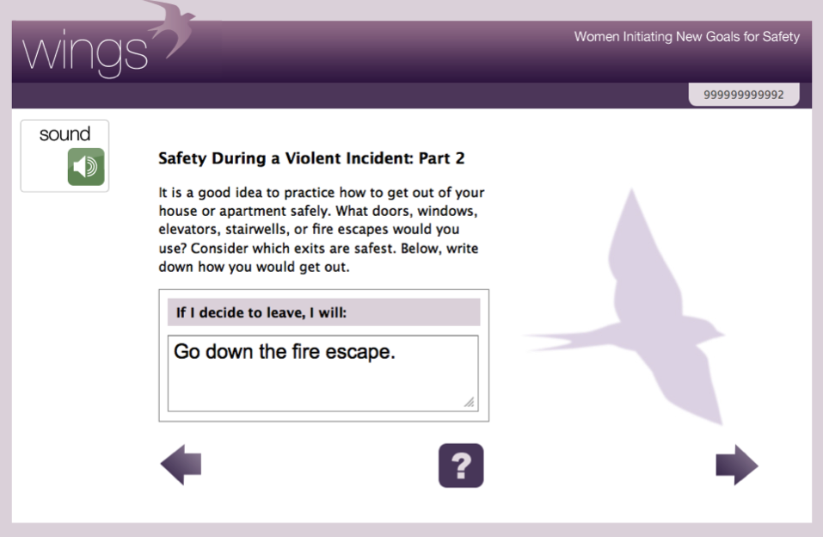

Slide 28
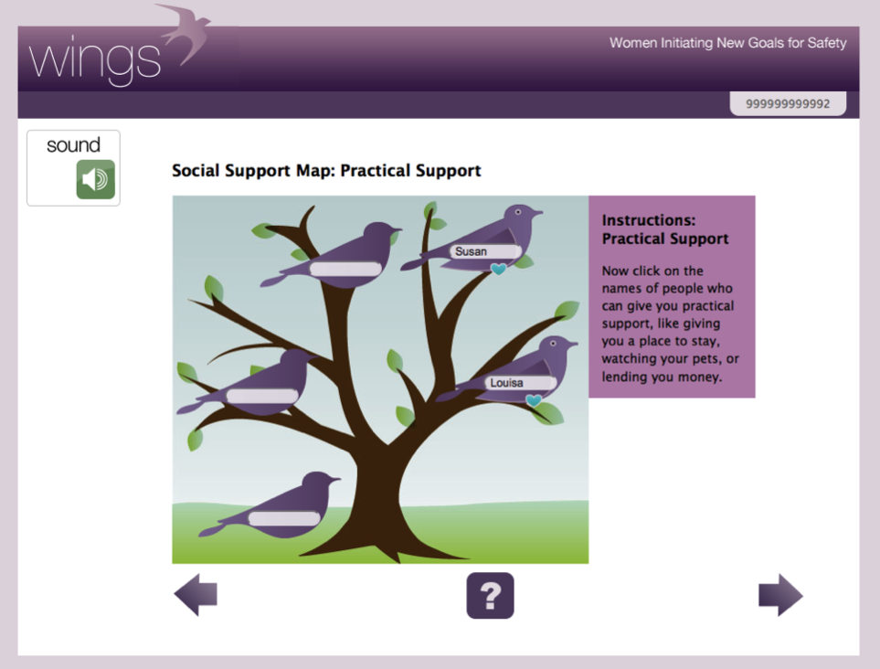

Slide 29
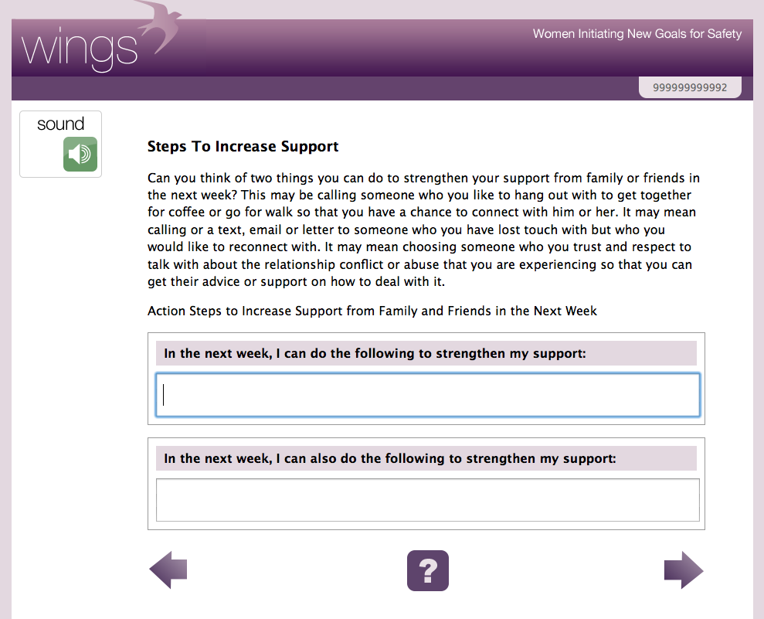

Slide 30
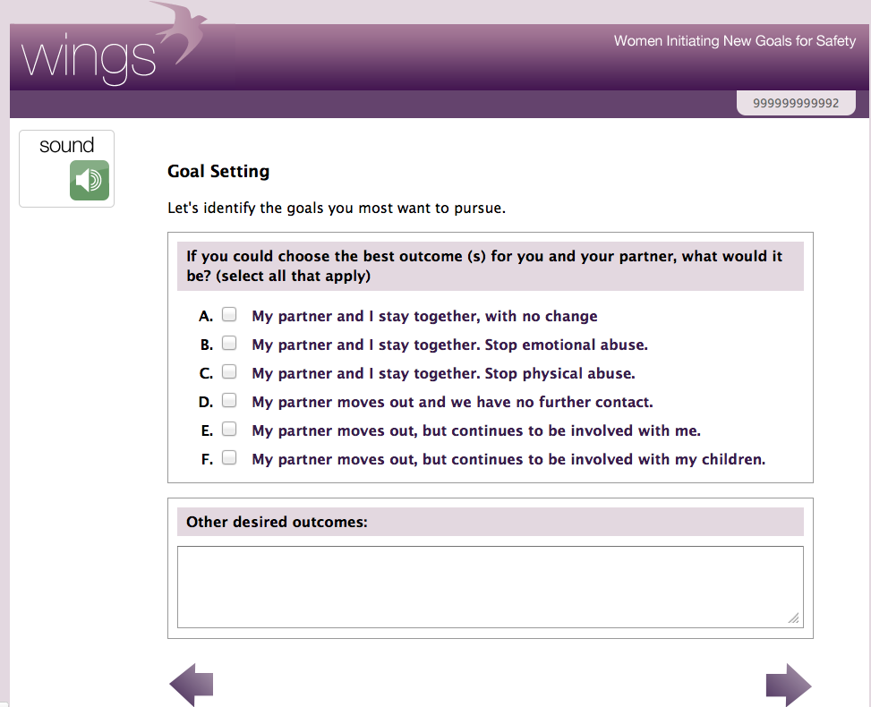

Slide 31
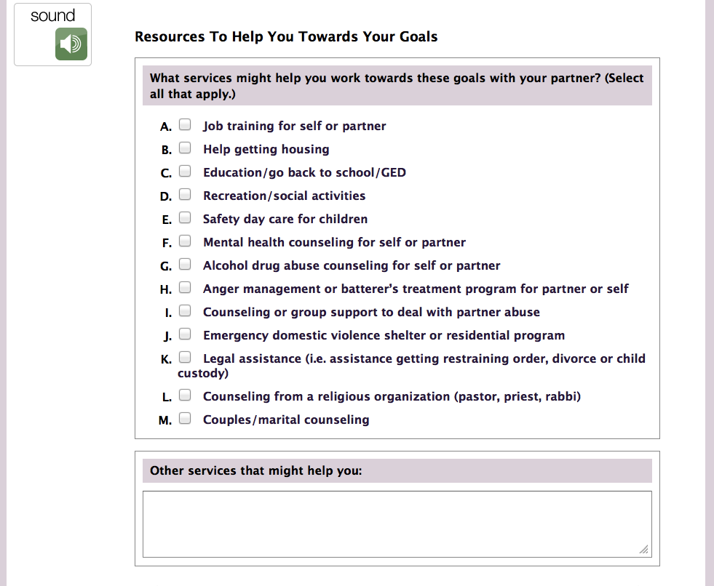

Slide 32
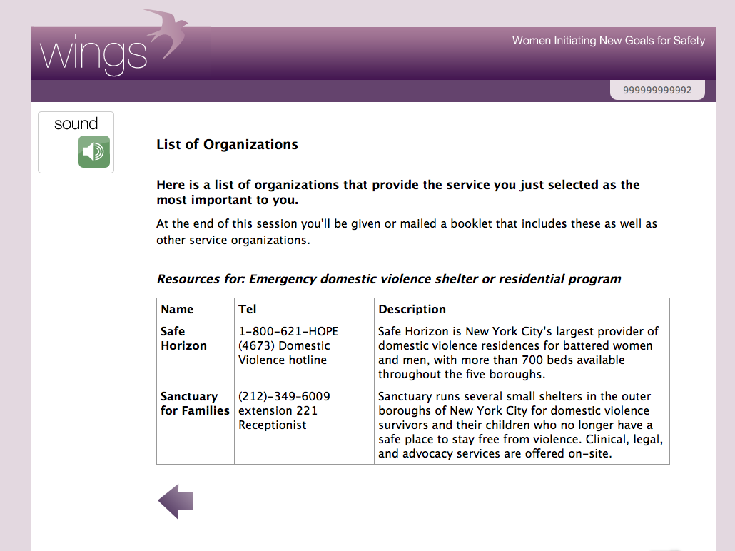

Slide 33
Lessons Learned: Resources needed to implement WINGS successfully
Training/
Supervision
Time
Leadership
Commitment
Coordinated
IPV Services
Tools
Confidential
Safe Space
Notes:
.

Slide 34
Building a Community Network of Coordinated IPV Services
HIV/STIs
Reproductive Health
Poverty Alleviation
Employment
Harm Reduction
Substance Use Treatment
IPV Services
Legal
Housing
NO WRONG DOOR !
Trauma
Mental Health
Notes:
34

Slide 35
Potential benefits of a computerized
self-paced GBV SBIRT model
Studies show WINGS computerized model is equally effective in identifying and reducing different types of GBV as WINGS delivered by a clinician or counselor (Gilbert et al., 2015; Gilbert et al., 2016).
May provide greater sense of privacy and confidentiality, particularly in settings where women are fearful of disclosure
May extend reach of IPV services in overburdened high caseload settings
May be culturally tailored and translated into different languages in settings where there are a lack of bilingual speaking staff
Can generate aggregate data that can be used to inform policy and programs to address GBV
May be used to pivot around COVID restrictions!

Slide 36
FUTURe Directions to tackle CovID-19/IPV syNDEMIC
Collect aggregate data on IPV and other types of gender-based violence (GBV) to document scope and severity of public health threat of violence against women in communities hit hard by COVID
Use data to target policy and culturally tailored program efforts to redress IPV and GBV among women in high burden communities
Integrate IPV prevention and brief interventions like WINGS in COVID prevention, testing and contact tracing initiatives (e.g. social media campaigns, COVID
Ensure universal access to internet and smart phones and use social media to encourage groups to connect and direct individuals to trusted resources for all types of support

Slide 37
Moving UPSTREAM tackling COVID-19/IPV SYNDEMIC
Mobilize key stakeholders (e.g. local government reps, faith-based leaders, providers, survivors) in high burden communities to advocate for IPV/COVID prevention resources, coordinate community response and tackle structural drivers (e.g. racism)
2. Target economic assistance/cash transfers/ to high burden communities using data driven approaches.
Increase federal, state, local funding for DV agencies to meet surge in demand.
4. Ensure DV staff receive adequate financial and emotional support as critical essential workers in the COVID-19 pandemic.
STRUCTURAL DRIVERS
RACISM, INCOME INEQUALITY, MASS INCARCERATION AND LACK OF ACCESS TO UNIVERAL HEALTH CARE

Slide 38
Thank you & Get in touch
Contact: Louisa Gilbert at lg123@columbia.edu
Access all WINGS articles and resources at
projectwings.org
Follow SIG on Twitter @ColumbiaSIG
Sign up for our e-newsletter: http://sig.columbia.edu/
COVID ACTION RESOURCES: https://blogs.cuit.columbia.edu/cssw-covid19resources/
We at CSSW condemn anti-Black racism in all its forms and are committed not just to making statements, but to taking action.

Slide 39
How confident are you to screen women for intimate partner violence and link them to services?
POLL
Not at all confident
A little confident
Somewhat confident
Confident
Very Confident

Slide 40
Hotline/text services
The National Domestic Violence Hotline is 24/7, confidential and free:1-800-799-7233 and through chat.
The National Sexual Assault Hotline is 24/7, confidential and free:800.656.HOPE (4673) and through chat.
The StrongHearts Native Helpline for domestic/sexual violence is available 7am-10pm CT, confidential, and specifically for Native communities:1−844-762-8483
The Trans LifeLine for peer support for trans folks 9am-3am CT:1-877-565-8860 This hotline is staffed exclusively by trans operators is the only crisis line with a policy against non-consensual active rescue.
The Deaf Hotline is available 24/7 through video phone (1-855-812-1001), email and chat for Deaf, DeafBlind, DeafDisabled survivors.
National Parent Helpline Monday -Friday 12pm-9am

